Slide 1
Graphics in R with ggplot
Yunkang Yang
yunkang@uw.edu
CSSCR
Communication department

Slide 2
Why ggplot?
Base graphic functions in R are plot(), points(), and lines(). With base graphics, you have complete control over every pixel in a plot but it can take a lot of time and code to produce a plot.
Base graphics is very good for polished and fully-customized plots for publication
ggplot2 is very good for rapid data exploration

Slide 3
Set it up
install.packages(“ggplot2”)
library(ggplot2)
theme_set(theme_bw())

Slide 4
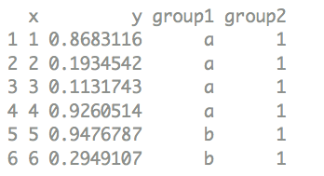
Set it up
library("ggplot2")
theme_set(theme_bw())

Slide 5
Create a scatterplot
ggplot(data = d) + geom_point(aes(x, y, colour = group1)) + facet_grid(~group2)
Notes:
Ggplot() is the data function

Slide 6
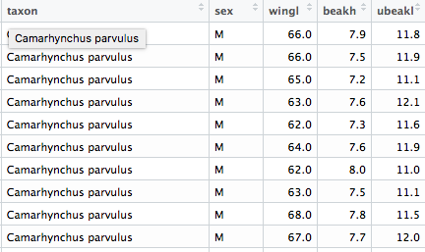
Create a scatterplot
read.csv(“data.csv”)
Notes:
I've set the alpha (opacity) value to 40%

Slide 7
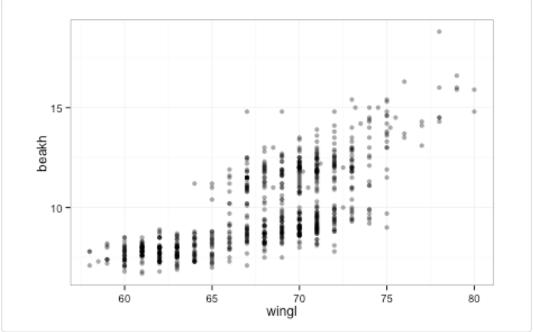
Create a scatterplot
read.csv(“data.csv”)
ggplot(morph, aes(wingl, beakh)) + geom_point(alpha = 0.4)
Notes:
I've set the alpha (opacity) value to 40%

Slide 8
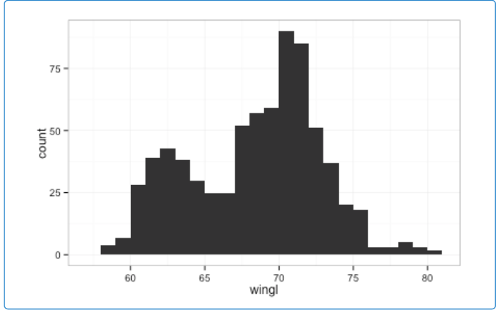
Generate a histogram
ggplot(morph, aes(wingl)) + geom_histogram(binwidth=1)

Slide 9
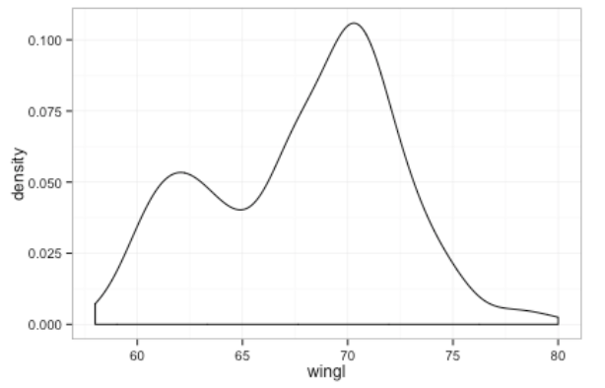
Create a Density plot
ggplot(morph, aes(wingl)) + geom_density()

Slide 10
Aesthetics
Aesthetics refer to the attributes of the data you want to display. They map the data to an attribute (such as the size or shape of a symbol) and generate an appropriate legend. Aesthetics are specified with the aes() function.
As an example, the aesthetics available for geom_point() are: x, y, alpha, colour, fill, shape, and size.
Notes:
Read the help files to see the aesthetic options for the geom you’re using. They’re generally self explanatory. Aesthetics can be specified within the data function or within a geom. If they’re specified within the data function then they apply to all geoms you specify.

Slide 11
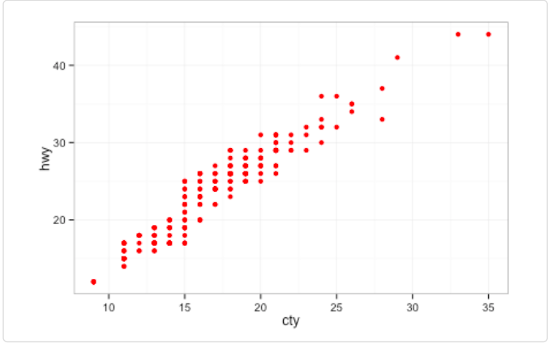
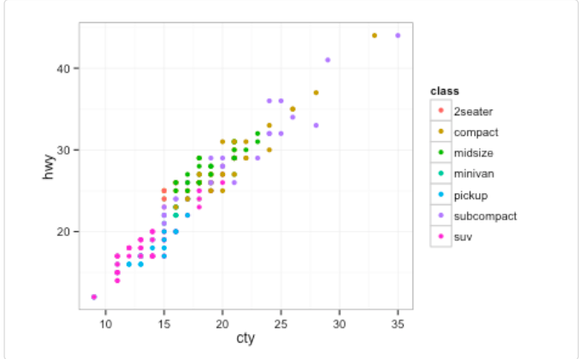
Aesthetics
There is an important difference between specifying characteristics like colour and shape inside or outside the aes() function: those inside the aes()function are assigned the colour or shape automatically based on the data. If characteristics like colour or shape are defined outside the aes()function, then the characteristic is not mapped to data. Here’s an example:
ggplot(mpg, aes(cty, hwy)) + geom_point(colour = "red")
ggplot(mpg, aes(cty, hwy)) + geom_point(aes(colour = class))

Slide 12
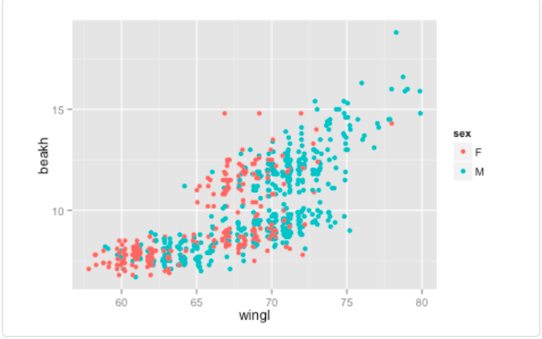
Aesthetics
ggplot(morph, aes(wingl, beakh)) + geom_point(aes(colour = sex), position = position_jitter(width = 0.3, height = 0))

Slide 13
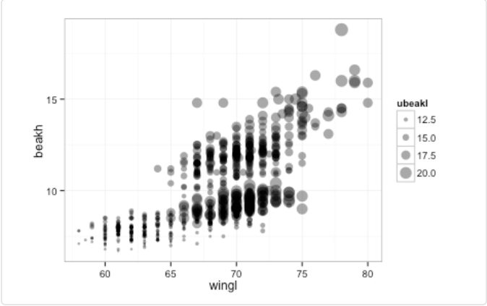
aesthetics
try the same scatterplot but show upper beak length (ubeakl) with size
ggplot(morph, aes(wingl, beakh)) + geom_point(aes(size = ubeakl), alpha = 0.4)

Slide 14
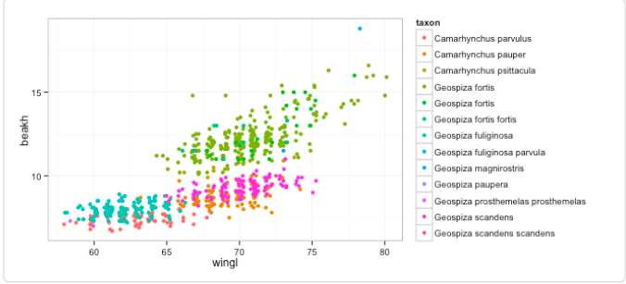
aesthetics
try the same scatterplot but show the taxon with colour
ggplot(morph, aes(wingl, beakh)) + geom_point(aes(colour = taxon), position = position_jitter(width = 0.3, height = 0))

Slide 15
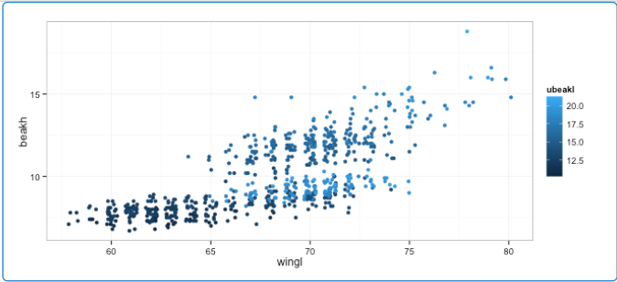
aesthetics
try the same scatterplot but show the upper beak length with colour (note how ggplot treats ubeakl differently than taxon when it picks a colour scale)
ggplot(morph, aes(wingl, beakh)) + geom_point(aes(colour = ubeakl), position = position_jitter(width = 0.3, height = 0))

Slide 16
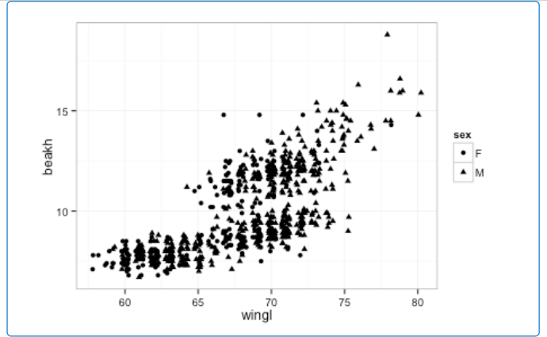
aesthetics
try the same scatterplot but show the sex with a different shape
ggplot(morph, aes(wingl, beakh)) + geom_point(aes(shape = sex), position = position_jitter(width = 0.3, height = 0))

Slide 17
facets
Notes:
scatterplot of beak height against wing length with a different panel for each taxon.

Slide 18
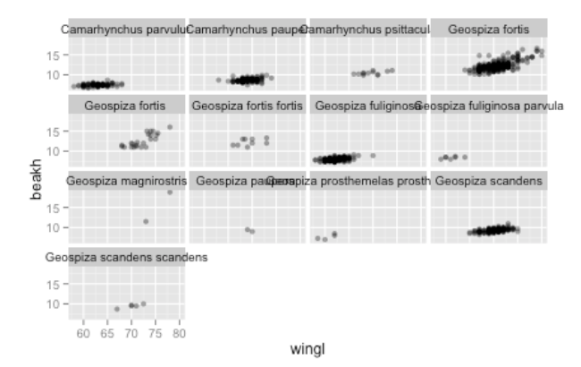
facets
ggplot(morph, aes(wingl, beakh)) + geom_point(alpha = 0.4) + facet_wrap(~taxon)

Slide 19
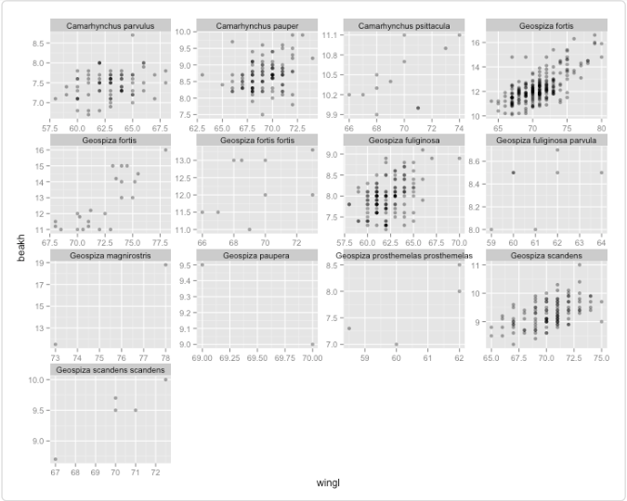
Facets
Sometimes it's useful to let the x or y axes have different scales for each panel.
ggplot(morph, aes(wingl, beakh)) + geom_point(alpha = 0.4) + facet_wrap(~taxon, scales = "free")

Slide 20
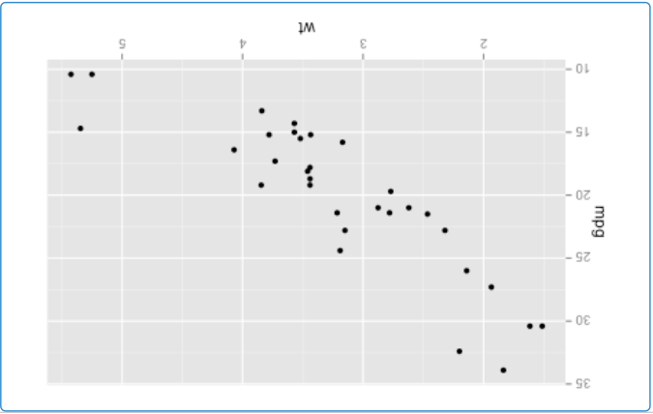
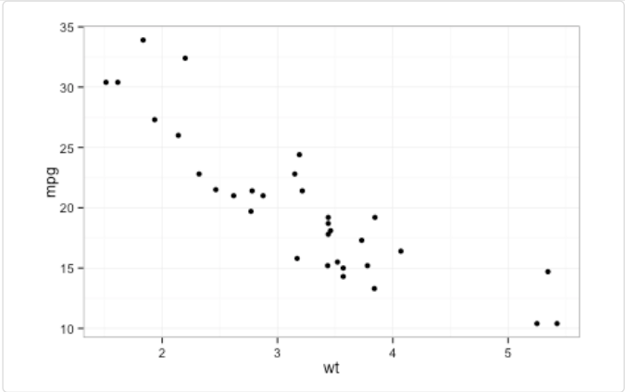
Customization in ggplots
theme_bw()
theme_grey()

Slide 21
Dot and line plots
ggplot2 can be useful for quickly making dot and line plots. For example, this is useful for coefficient plots. To illustrate how to make this style of plot, let's make a plot that shows a dot for the median and line segment for the quantiles. First, we'll calculate these values using the dplyr package and data pipes. Run the following code:

Slide 22
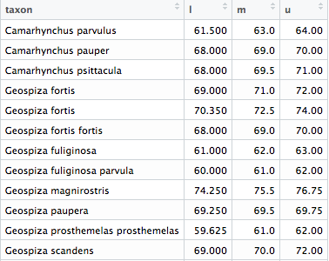
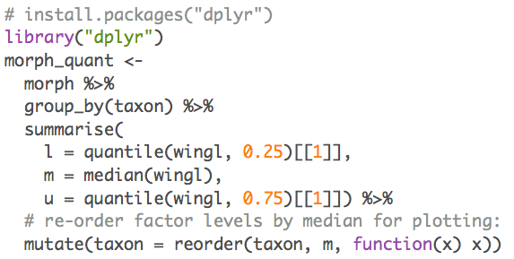

Slide 23
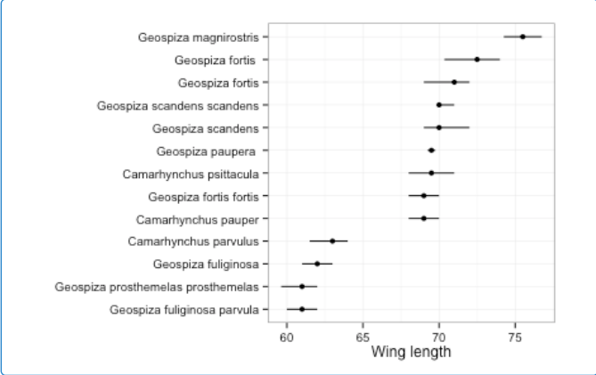
Make a boxplot
ggplot(morph_quant, aes(x = taxon, y = m, ymin = l, ymax = u)) + geom_pointrange() + coord_flip() + ylab("Wing length") + xlab("")
Notes:
Now make the plot. The final plot should have the taxa listed down the y-axis and the wing length value on the x axis. Use the geom geom_pointrange(). Because this geom only works for vertical line segments, you'll need to rotate the whole plot by adding + coord_flip(). So, ymax and ymin refer to the maximum and minimum line segment values and x to the taxa, even though they will appear rotated in the end.

Slide 24
Adding model fit to the data
ggplot2 can add model fits to the data to help visualize patterns. For example, it can quickly add linear regression lines, GLMs, GAMs, and loess curves.
Let's add loess curves to scatter plots of beak height and wing length with a panel (facets) for male and female.

Slide 25
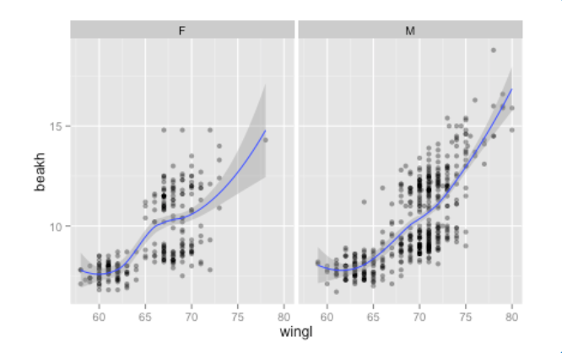
Adding model fit to the data
ggplot(morph, aes(wingl, beakh)) + geom_point(alpha = 0.4) + facet_wrap(~sex) + stat_smooth(method = "loess")

Slide 26
Displaying and saving ggplot2 plots
There is a convenience function ggsave("filename.pdf"), which will save the last plot to a PDF and guess at reasonable dimensions. You can, of course specify which plot to save and the dimensions of the PDF. You can also use all the same methods of saving ggplot plots that you can use for base graphics.

