Slide 2
Significance tests
Suppose you have a survey based on a sample of 500 people. You find that female respondents post selfies on the Internet much more than male respondents.
There seems to be a relationship between gender and posting selfies. But how do you know if the relationship you find in the sample really exists in the population?

Slide 3
Significance tests
Notes:
A significance test relies on the logic of falsification—gathering evidence for the existence of something by demonstrating what it is not. An analogy of guessing what’s inside a gift box helps demonstrate that we actually use this style of reasoning in everyday life.
Imagine that you get a nicely wrapped gift in a box from a friend. You’re told not to open the box, but of course you can’t help trying to guess what’s inside. Say you have several guesses (hypotheses) about what’s inside the box: a bicycle, a book, or a box of fancy marshmallows (your friend has funny tastes). Just by observing the size of the box, however, you rule out the bicycle hypothesis—it’s just too small, even if the bike were disassembled. So it’s nota bike. But it could still be a book or a box of marshmallows. Then you pick it up and realize it’s much too lightweight to be a book. So you conclude it’s nota book. You’ve now got evidence in favor of the marshmallow hypothesis by eliminating other possibilities. Of course, you still can’t be sure what really isinside the box.

Slide 4
The logic of significance test
A significance test relies on the logic of falsification—gathering evidence for the existence of something by demonstrating what it is not.
We want to show that there is a relationship between gender and posting selfies in the population.
So we want to show that the opposite is unlikely to happen.
Our hypothesis is that there is a relationship between gender and posting selfies in the population.
The Null hypothesis we want to reject is that that there is no relationship between gender and posting selfies in the population.
Notes:
A significance test relies on the logic of falsification—gathering evidence for the existence of something by demonstrating what it is not. An analogy of guessing what’s inside a gift box helps demonstrate that we actually use this style of reasoning in everyday life.

Slide 5
Significance tests
Null hypothesis
What we directly test
Often the null is a claim of no difference, no effect, or no relationship
Ex: On average, wages of men and women are the same (there is no difference)
Alternative hypothesis
Often what we are interested in proving
Logical alternative to the null hypothesis
Ex: Men have higher average wages than women

Slide 6
Significance tests: Basic Idea
We have a finding from the data.
If the null hypothesis is true, it is highly unlikely that we have this finding from the data. We reject the null hypothesis.

Slide 7
Statistics and probability theory tell us that this test statistic takes the shape of a t distribution (which looks much like a normal Z distribution, as we mentioned earlier, although a bit flatter and more spread out).
The statistical software does the t-test calculations for us, so we won’t worry about the details here (you can find them in any introductory statistics textbook). The computer tells us that a t statistic of −1.729 has a probability of .084 (or 8.4%). The next thing to do is figure out what this probability—or p value—tells us.

Slide 8
8/7

Slide 9
Steps of doing a significance test
1 Form a null hypothesis.
2 Compute the test statistics.
3 Compute the p value.
4 Decide if the p value is small enough.

Slide 10
Running a significance test
Suppose we have a random sample survey of middle school students in the United. Suppose we wonder if boys and girls differ in their academic achievement, as measured by a composite (reading and math) test score. Boys on average scored 50.4 while girls on average scored 51.5, over a point higher.
But our data come from a sample of only n = 1,085 middle school students from a much larger population.
So perhaps we just got this difference by chance, the luck of the draw as it were, when in reality there is no difference in test scores between middle school boys and girls in the United States.
How do we know if the difference between boys and girls truly exist in the population?
We need a significance test.

Slide 11
Running a significance test
You should recognize this as a null hypothesis of no difference in the population between boys and girls.
But how do we tell if the difference in the means we see in our sample is large enough to rule out a null of no difference? The standard error—as a gauge of sampling variability—provides a benchmark.
We can ask, “Is the observed difference large or small relative to the standard error?” If the difference is large relative to the standard error, then it is unlikely to be just a fluke of sampling, and we can probably rule out the null of no difference.
To make this idea more formal, we construct what is called a test statistic:

Slide 12
Steps of doing a significance test
1 Form a null hypothesis.
2 Compute the test statistics.
3 Compute the p value.
4 Decide your P threshold and decide if the p value is small enough to meet the threshold.

Slide 13
Step 1
Null hypothesis: there is no relationship between girls and boys in our test score.
Step 2
Test statistic = (Estimate − Null)/SE
In our case, the sample estimate of the difference in means was −1.072 test points (meaning boys scored 1.072 points lower than girls, on average). The null hypothesis is no difference, or 0.000 points. The computer finds the standard error of the difference to be .620, so we have
Test statistic = (−1.072 − 0.000)/0.620 = −1.729.

Slide 14
Step 3
the p value 0.084

Slide 15
Step 4
P value is small enough. We reject the Null hypothesis.
We are confident that there is a difference between boys and girls regarding test scores in the population.

Slide 16
Two sample t-test
Assumptions
1 Two samples are independent--there is no relationship between the individuals in one sample as compared to the other
2 the data is continuous
3 The data follow the normal probability distribution.
4 The variances of the two populations are equal.
5 Both samples are simple random samples from their respective populations.

Slide 17
P value
The probability associated with a test statistic is called a p value for short. Here is its meaning: A p value represents the probability of observing the sample estimate (or an estimate even further from the null) when the null hypothesis about the population is true.
In our example, the p value tells us that with a random sample of n = 1,085, we have an 8.4% chance of observing a difference of 1.072 test score points (or more) when in the population there is really no difference in means between boys and girls (the null).
Or to put it another way, in a world in which boys and girls have the same test scores in the population (the null), a sample of n = 1,085 would by chance show a difference in means as large as (or larger than) our results only 84 times in 1,000.
You decide to reject the null hypothesis because the p value 0.084 is very low.

Slide 18
How low should the p value be for us to reject the null hypothesis?
It depends.
Common criteria.
0.1
0.05
0.01

Slide 19
P values
P value
Probability of observing our sample estimate (or an estimate further from the null), if the null hypothesis about the population is true
Low p value → more statistical significance ➔ null very unlikely, alternative possible
How low is low enough?
Common convention: .05 or less
Ex: p=.032 ➔ There is a 3.2% chance we could have gotten the difference we did if there was really no difference.
p values universal

Slide 20
Running a significance test
Calculate a test statistic
Estimate a difference or relationship using sample data
Compute how far the estimate is from the null (of no difference, no relationship)
Divide by the sampling variability (standard error)
Test statistic = (Estimate − Null) / SE
Find the p-value
Probability of the estimate, when the null is true
Use software or a table to find the p-value
If p-value is small enough (for example, p < .05), null hypothesis can be rejected as being inconsistent with the data

Slide 21
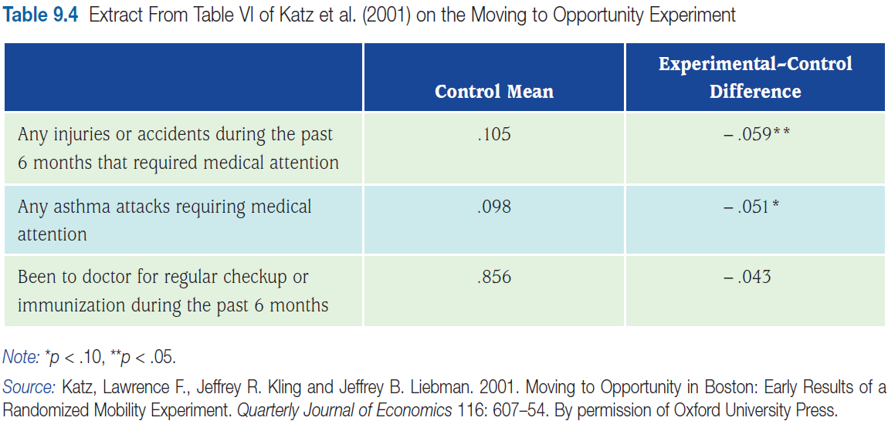
Interpreting p values for differences
Which differences are statistically significant?
At the 5% level? At the 10% level?
Which differences are practically significant?

Slide 22
Significance tests for simple regression
Null hypothesis that coefficient is zero
t statistic tells us how many standard errors the point estimate of the coefficient is from zero

Slide 23
1 T test
One categorical variable, one continuous/quantitative variable
2 Regression
Two continuous variables
3 Chi-square test
Two categorical variables

Slide 24
Chi-square test
 | gender | post selfies
Mike | M | yes
Bob | M | no
Mary | F | yes
Tanya | F | yes
Nick | M | no
…
Are men more likely to post selfies than women?
Is there a gender difference regarding posting selfies?

Slide 25
Chi-square test
Cross-tabs show the relationship between categorical variables
Chi-square tests if the relationship is statistically significant
Null hypothesis: no relationship
Calculate counts expected if no relationship
See how far observed counts from expected counts
If far, the null of no relationship is unlikely (low p-value)

Slide 26
Chi-square test
How the chi–square formula works:
Step 1: Find the expected count (expected if no relationship) in each cell in this way: (Row total × Column total)/Table total
Step 2: Calculate the chi–square statistic = χ² = Σ (Observed – Expected)²/Expected
Step 3: Look up the associated p value using a chi–square table or software.
 | Male | Female | Total
Selfies | 35 | 30 | 65
No selfies | 50 | 40 | 90
Total | 85 | 70
Expected count for male who post selfies 85*65/(65+90)
Notes:
41.9% eat break fast in general

Slide 27
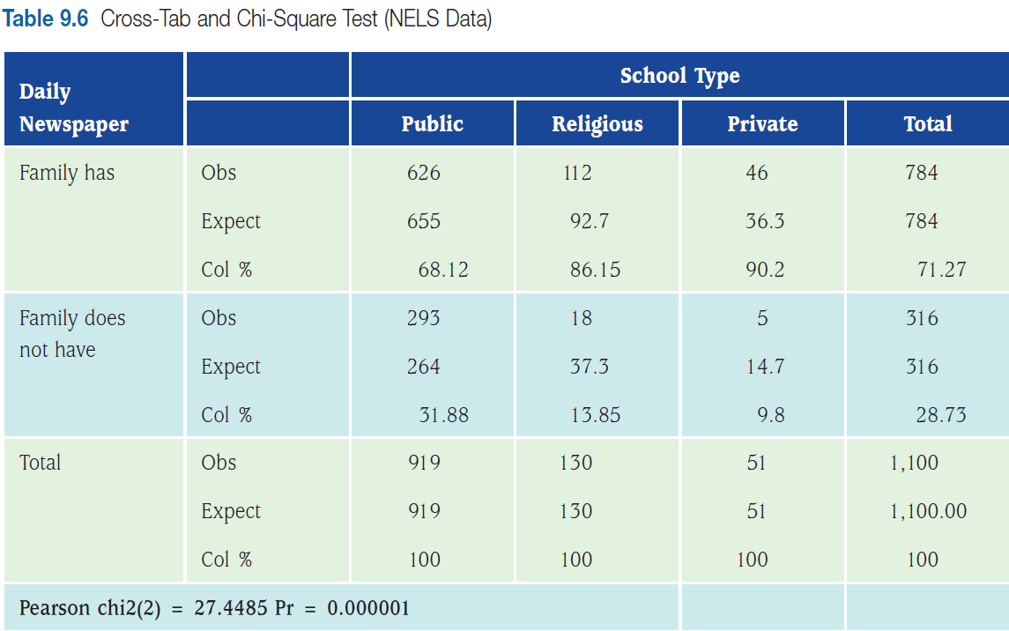
Crosstab and Chi Square Test

Slide 29
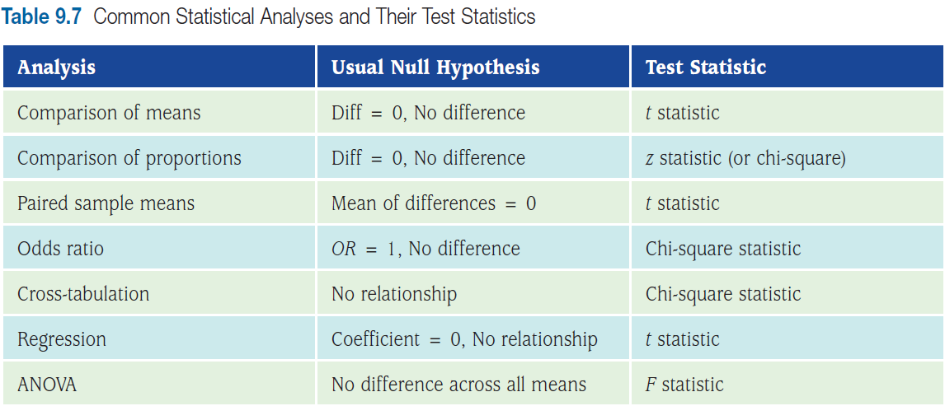
Other common statistical analyses and their tests

Slide 30
Correctly interpreting a P Value
The P value is the probability that one could have observed the result one did—or one even further from the null hypothesis—if the null hypothesis were true
The cumbersomeness of this interpretation leads people to frequently misinterpret the p value
People tend to erroneously interpret the p value as the probability that the null hypothesis is true, but that interpretation is wrong and can be misleading.

Slide 31
Practical significance
Magnitude matters
Practical significance
Of a difference (in means) or relationship (between variables)
Extent that the magnitude (if true) would be important or relevant in the real world
Depends on judgment
Must be able to interpret results in units and ways relevant to practice and policy
Notes:
31

Slide 32
Statistical significance v. practical significance
Don’t read too much into statistical significance test results
Two causes for statistical significance
(A) Large difference that swamp standard errors
➔ Practical significance really there
(B) Very small standard errors
Usually due to very large sample size
Very precise measures
Small practically insignificant differences still large compared to tiny standard errors
Statistical significance does not necessarily mean practical significance

Slide 33
Statistical significance v. practical significance
Two causes for statistical insignificance
(A) Large standard errors
Usually due to small sample size
Large differences could be a fluke of who sampled
No statistical significance does not mean you know that there is no practical significance
Just don’t know
(B) Very small differences
With sufficiently narrow confidence intervals, you know that no practically significant differences exist
Notes:
33

Slide 34
Type I and Type II errors
Type I error
Null is true but we reject it
Lower critical p ➔ less type I error
Type II error
Failure to recognize a difference or effect
Accepting null when it is false and alternative is true
Notes:
34

Slide 35
Wednesday’s lab
Location: SAV 117

Slide 36
Quantitative methods assignment

