Slide 1
Introduction to communication
Yunkang Yang
COM 200
Summer 2019

Slide 2
When and where we meet?
MWTTh 3:30-5:40 PM (CMU 242)

Slide 3
Objectives
Analyze communication and identify where problems have occurred.
Better understand the online information environment.
Articulate some of the core ways communication reflects, shapes, and disrupts our personal and public lives.
...
Notes:
1 communication problems introduced by new media technology. (Facebook unfriend). What does it mean? Friendship severd? No longer friends? Run into this person what to do?
Fake news
Disinfomation
Doctored video of Nancy Pelosi
Privacy issues in online environment, is it safe to use google chromes?

Slide 4
Course website
The course website can be found at https://canvas.uw.edu/courses/1303300

Slide 5
Assignments and gradings
Assignments: | Contribution to Final Grade:
Short Assignments (x4) | 20%
Participation | 10%
Exam 1 | 20%
Exam 2 | 20%
Final Exam | 30%
Total | 100%

Slide 6
Short assignments
There are 4 short (maximum 500 word) reflection essays. Each reflection asks you to think about an idea or concept from the course and relate it to a current event or personal experience. Prompts will be posted on the course Canvas site one week in advance of each due date. 500 words equal about 2 double-spaced pages. You should write in complete sentences, use paragraphs, spell check, and proofread. Also, for each assignment, EVERY word (including quoted words) count toward the total word count. No late reflection papers will be accepted.
7/1 First assignment due
7/8 Second assignment due
7/15 Third assignment due
7/23 Fourth assignment due

Slide 7
Participation
Attentive participation in class discussions and activities are essential for a robust educational environment. You are expected to actively ask questions and speak up during lecture and discussion activities. Also, there will be in class activities upon which you are evaluated. These in-class activities will count towards your participation scores.

Slide 8
Exams
There will be three cumulative exams. Exams include content from lectures, readings, discussions, short assignments, or in-class activities. Dates are specified in the syllabus. Each of the first two exams has 14 multiple choice questions (1 point each) and two short answer questions (3 points each). Students are expected to finish it within 90 minutes. The third exam is the final exam which has 27 multiple-choice questions (1 point each) and three short answer questions (1 point each). Students are expected to finish the final exam within 90 minutes. No scantron sheets are needed. There are no make-up exams.

Slide 9
Extra credit opportunities
Specific extra credit opportunities will be announced on 7/1.
Notes:
It involves coding news articles. For example, I will ask you to read an article related to the Ford-Kavanaugh controversy and determine whether it is
Against or …

Slide 10
How to succeed in this class?
Do come to class!
Do come to class with your reading completed.
Don’t surf the web, send text messages, buy shoes, watch movies, etc.
Do study class material every day so you don’t have to cram for exams.
Don’t wait until the last minute to submit your reflections.

Slide 11
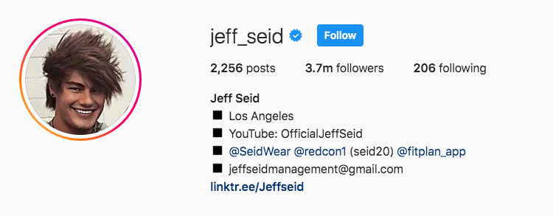
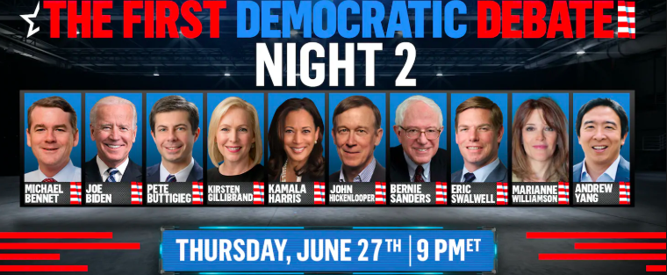
We will also have fun in this class!
We will watch the first 2020 Democratic debate and apply what we’ve learned in class to evaluate the performance of presidential candidates!
We will have a guest lecture on how Instagram body image influencers make money!

Slide 12
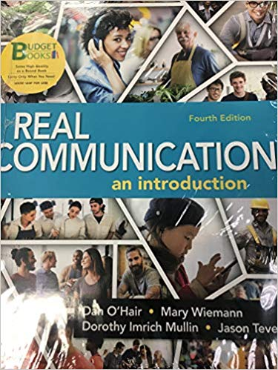
Required text for this class
O’Hair, Weimann, Mullin & Teven (2017), Real Communication: an introduction. 4th edition. Bedford/St. Martin’s

Slide 13
Additional readings
Julia, K. (2018) Why are young people having so little sex? the Atlantic, https://www.theatlantic.com/magazine/archive/2018/12/the-sex-recession/573949/
Konnikova, M. (2014) The limits of friendship, the New Yorker,
https://www.newyorker.com/science/maria-konnikova/social-media-affect-math-dunbar-number- friendships
Burdick, A. (2017) “The A.I. ‘gaydar’ study and the real dangers of big data,” The New Yorker.
Menard, L. (2017) “Why do we care so much about privacy? The New Yorker.
Moy P., Tewksbury, D. & Rinke, E. (2016) Agenda-setting, priming, and framing, the International Encyclopedia of Communication Theory and Philosophy

Slide 14
Self-introduction
What do you choose this class?
What do you expect from this class?
Which top on the syllabus is most interesting to you?

Slide 15
Email policy
Email is formal communication, and I expect it to be composed as such. Please include a clear subject heading (including the course number); proper spelling, grammar and punctuation; and an appropriate salutation, valediction, and signature. Without these elements, I may not be able to adequately respond to your email. For example, it can be difficult or impossible to answer an emailed question if the email fails to indicate the identity of its author.

Slide 16
Group activity: what is wrong with this email?
From: student@college.edu
Sent: Tuesday, September 9, 2015 11:42 A.M.
To: professor@uw.edu
Subject: Hey
Hey, sorry I missed class today … I had a little too much fun last nite had a rough time waking up ;)
Can you email me your teaching notes SAP? Tnx.
Notes:
Group discuss, how is this communication inappropriate

Slide 17
Structure of this class

Slide 18
First week
We will explore the following questions:
1 How to make our communication behavior effective?
2 How does communication affect our identity?
3 What is the difference between language and the so called “body language”? Is “body language” really a language?
4 What are some of the most important cultural differences we experience when we communicate?

Slide 19
What is communication?
Communication is the process by which we use symbols, signs, and behaviors to transfer information.
Notes:
Successful communication allows us to satisfy our most basic needs, from finding food and shelter to functioning in our communities and developing meaningful relationships; it allows us to both produce and enjoy humor, as Fallon does.
I am gonna tell you two stories to show why communication is so essential to our well being.

Slide 20
Why do we study communication?
Notes:
I am gonna tell you two stories to show why communication is so essential to our well being.

Slide 21
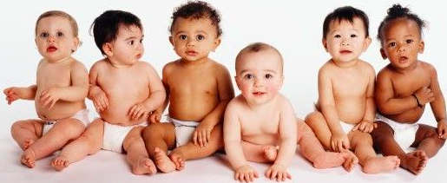
First story: poverty and communication
Notes:
A study has found that
By 18 months, children from wealthier homes recognize words for
Familiar objects much faster than ones from less wealthy homes.
By 24month children from wealthier homes learn 30% more words than poor children.

Slide 22
It is not about wealthier and better educated people being smarter…
But because children in poverty hear fewer words and have fewer interactions. In other words, they do not get the same opportunities to develop language skills.
Notes:
It’s about talk.
Kids get smarter when you talk to them

Slide 23
What kind of talk is helpful?
Modeling interaction before the child begins to talk.
e.g. Mother: “Are you hungry? Do you want cereal? Where shall we find cereal?”
Notes:
So part of the problem, the problem of the gap of social skills or even intelligence between
Rich and poor kids is a communication problem.
Research shows that two kinds of talk are especially important.

Slide 24
What kind of talk is helpful?
Modeling interaction before the child begins to talk.
Waiting for and responding to what the child says.
Child: Ball gone.
Parent: Is it over there?
Notes:
Conversational turn taking is very important.

Slide 25
Notes:
Because how parents talk with children has a profound effect their brain development, many cities and foundations launched media campaigns aimted
At parents.
Such as this program in Seattle, called Vroom, is to help parents to communicate with their children effectively.

Slide 26
Second story: kisses and health
Notes:
Kissing is also a way of communication. It is a way for us to express affection. But it is also good for our health.
Studies by Kory Floyd and others, Arizona state U in 2009, western journal of communicaiton,

Slide 27
The research team recruited 52 people who were in a married or cohabitating relationship.
Half male, half female aged 19 – 67
Randomly divide them into kissing group and control group.
Notes:
Kiss group: kiss at least three times a day.
Control group: received messages that have nothing to do with kissing, and complete surveys.
Run basic medical test

Slide 28
Findings
Psychological effect: Increased satisfaction with their relationship.
Physiological effect: decreased total cholesterol
Notes:
Researchers found that people from the kiss group

Slide 29
Takeaway
The way we communicate, even something as simple as kissing has a profound effect on our health.

Slide 30
Why study communication
Isn’t it all common sense?
Well, a lot of communication are commonsense. But commonsense does not take us far enough…
Commonsense is often contradictory.

Slide 31
The pen is mightier than the sword!
Sticks and stones may break my bones, but words will never hurt me.
Notes:
So which one is more true?
We cannot rely on common sense all the time because it often gives us contradictory directions.

Slide 32
How to better understand communication?
We need a model of communication process
Notes:
To better understand communcation, we need a way to think about the process to describe the parts.
We need to model

Slide 33
Let’s take a break!

Slide 34
Communication model
The linear model
The interactional model
The competent communication model

Slide 35
The linear model
Notes:
Sending a text message to someone, sending an email
Something you do to others
Key components
But one question first

Slide 36
Is meaning in the message?
I will call you back. (Does it really mean that she will call you back?)
I need more time and more space. (What does that mean?)

Slide 37
Encoding and Decoding
Notes:
Encoding is the process of mentally constructing a message: putting it into a symbol that can be sent to someone.
Decoding is the process of interpreting and and assigning meaning to a message that gets received.

Slide 38
Meanings are in our head
Messages influence meanings, but do not fully control them.

Slide 39
Encoding
Who is the source? Where did this message come from?
Sources can be individuals, groups, institutions, and so on.
You can communicate without knowing.
Notes:
Any examples of communication without knowing?
Maybe it is a viseral reaction? --
Maybe the person does not intend to communicate

Slide 40
Decoding
Who is the audience?
Assign meaning to message – interpret the message.
Meaning are in people.
Messages influence meanings, but do not fully control them.

Slide 41
Message
Anything that can register on other’s senses can be a message.
Messages can be unintentional.
The message you think you sent, may not be the one others receive.

Slide 42
Channel
The medium through which the messages moves from the source to receiver.
Question: what are some of our communication channels?
Channels influence what the message can be and how it will be interpreted.
Same messages across different channels may convey different meanings.
Hard to convey some messages in some channels.
Notes:
Face to face, phones, writing, internet videogames, hearing, sight touch small taste

Slide 43
There is something wrong with the linear model…
What is wrong with the linear model?

Slide 44
Any message the receiver creates in response to the source’ original message is feedback.
Source and receiver become interdependent.
We are sources and receivers at the same time.
Notes:
We are sources and receivers simultaneously.
As you are listening to me, you seem to be the receiver of my message. But as you are listening, you are also sending message about
How attentative you are, are you sitting in the front seat, are you playing with your phone while listening to me.

Slide 45
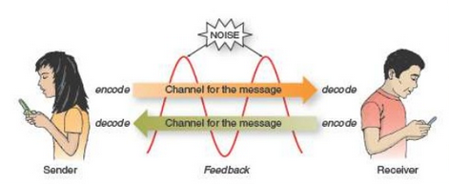
The interaction model

Slide 46
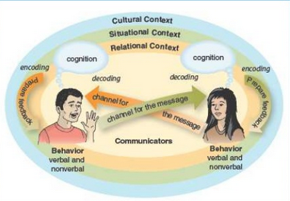
The competent communication model
Notes:
See the book real communication page 23

Slide 47
The communicators. Two individuals are shown here, but many variations are possible: one person speaking to an audience of two hundred, six individuals in a group meeting, and so on.
The relationships among the communicators (the relational context).
The situation in which the communication occurs (the situational context).
The cultural setting that frames the interaction (the cultural context).

Slide 48
Communicators and cognition
Notes:
The most obvious elements in any communication are the communicators themselves. When sending and receiving messages, each communicator is influenced by cognitions,
the thoughts they have about themselves and others, including their understanding and awareness of who they are (smart, funny, compassionate), how well they like themselves, and how successful they think they are.
We discuss in depth self-concept/perception in our next class.
For now, just understand that your cognitions influence your behavior when you communicate. Behavior is observable communication, including verbal messages (words) and nonverbal messages (facial expressions, body movements, clothing, gestures).

Slide 49
The Relational Context
Notes:
A kiss, for example, has a different meaning when bestowed on your mother than it does when shared with your romantic partner.

Slide 50
The Situational Context
Notes:
The situational context includes the social environment (a loud, boisterous party versus an intimate dinner for two),
the physical place (at home in the kitchen versus at Chicago’s O’Hare International Airport),
specific events and situations (a wedding versus a funeral),
and even a specific mediated place (a private message versus a tweet).
It matters …
Approrite to discuss work in a business setting
But may be not, talk shop in a party.

Slide 51
The Cultural Context
Notes:
Culture is the backdrop for the situation, the relationship, and the communicators themselves. As you will learn in Chapter 6, the communication aspects of culture encompass more than nationality; culture also includes race, gender, religion, sexual orientation, group identities, and so on. This cultural mix can create tensions and challenges but also incredible opportunities
The N* word, if you are black, and you are using this word while speaking anther black person,
It is different than …

Slide 52
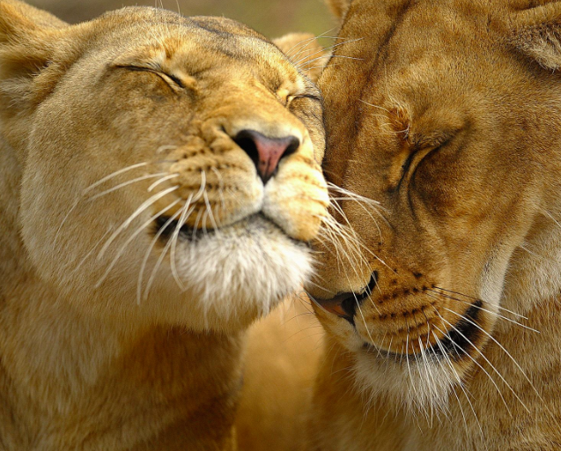
Functions of communication
Expressing Affiliation: the affect, or feelings, you have for others.

Slide 53
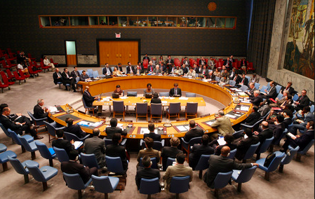
Functions of communication
Achieving goals.

Slide 54
Functions of communication
Influencing others

Slide 55
Five characteristics of communications

Slide 56
Five characteristics of communications
Communication relies on symbols.

Slide 57
Five characteristics of communications

Slide 58
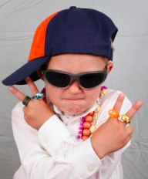
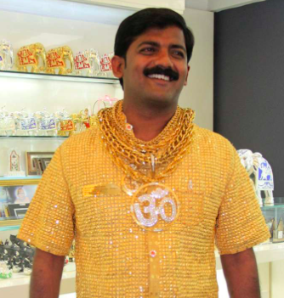
Five characteristics of communications
Communication relies on symbols.
Communication requires a shared understanding of a set of symbols (code).

Slide 59
Group activity
Recall a symbol that was alien to you and describe how you figured it out.

Slide 60
Five characteristics of communications
Communication relies on symbols.
Communication requires a shared code.
Communication is linked to culture.
Notes:
Culture refers to the shared beliefs, values, and practices of a group of people.
If you do not understand a symbol, it might be because the symbol comes from a different culture.
Think about a culture in which people never discover gold, or gold is as cheap as iron. Would what the rich man in india does make any sense? No.

Slide 61
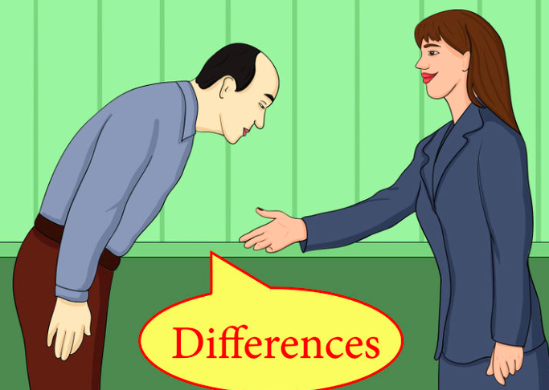
Five characteristics of communications
Notes:
Culture refers to the shared beliefs, values, and practices of a group of people.
Group activity

Slide 62
Five characteristics of communications
Is communication always intentional?

Slide 63
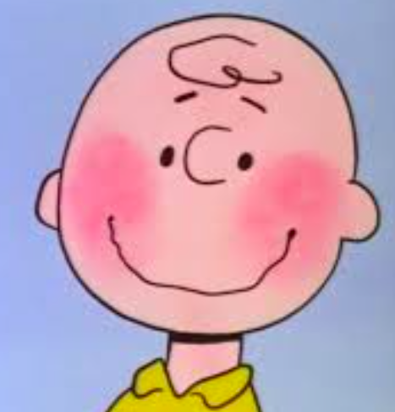
Five characteristics of communications

Slide 64
Five characteristics of communications
Communication relies on symbols.
Communication requires a shared code.
Communication is linked to culture.
Communication can be unintentional.

Slide 65
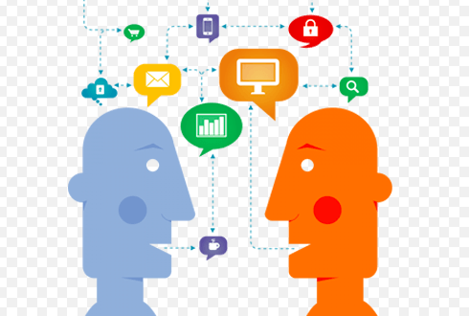
Five characteristics of communications
Email, Facebook, face to face…

Slide 66
Five characteristics of communications
Communication relies on symbols.
Communication requires a shared code.
Communication is linked to culture.
Communication can be unintentional.
Communication occurs through various channels.

Slide 67
Communication as a discipline
Political communication
Interpersonal communication
New media studies
Mass communication
Public speaking
Public relations
Rhetorical studies
Cultural studies

Slide 68
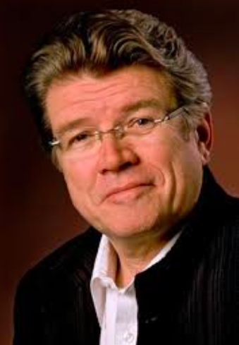
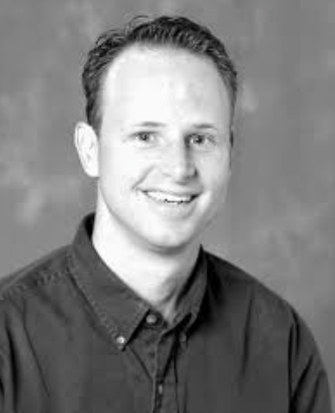
Political communication
Lance Bennett
Researchers are broadly interested in the relationship between politics and citizens and the communication modes that connect these groups to each other. Researchers examine how these forces interact with each other and affect one another.
COM 304 Press and politics in the United States.
COM 305 The politics of mass communication in America
COM 306 Media, society, and political identity
David Domke

Slide 69
Interpersonal communication
Researchers study process by which people exchange information, feelings, and meaning through verbal, non-verbal, or mediated channels.
COM 270 Interpersonal communication
Valerie Manosov
John Crowley

Slide 70
Mass communication
Matt Powers
This area is often associated with the practical applications of journalism (Print media), television and radio broadcasting, and film.
COM 301 Navigating info. Networks for Mass Media
COM 340 History of Mass Communication
COM 343 Effects of Mass Communication
Patricia Moy

Slide 71
New media
Scholars explore the intersections of computing, computational social science, the humanities, and the visual and performing arts.
COM 300 Basic concepts of new media
COM 302 the cultural impact of Info. Technology
COM 303 social effects of tech and social media
Ben Mako Hill

Slide 72
Public speaking
It concerns the act of performing a speech directly speaking to a live audience in a deliberate manner in order to inform, influence, or entertain them.
COM 220 intro to public speaking
COM 320 advanced public speaking
Matt McGarrity

Slide 73
Rhetorical studies
Rhetoric is the study and practice of communication that persuades, informs, inspires, or entertains target audiences in order to change or reinforce beliefs, values, habits or actions.
COM 238 Rhetoric and popular culture
COM 329 Rhetoric of social and political movements
COM 330 Rhetoric of science
COM 331 The rhetorical tradition in western thought
COM 332 History of Rhetoric
Leah Ceccarelli

Slide 74
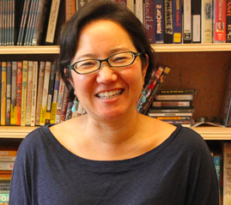
Cultural studies
Cultural studies is an innovative interdisciplinary field of research and teaching that investigates the ways in which “culture” creates and transforms individual experiences, everyday life, social relations and power.
COM 289 Communication power and difference
LeiLani Nishime

